Slide 1
Food Security Monitoring in Karamoja, Uganda
Analyzing Population, Area and Crop Yields to strengthen food security.

Slide 2
Project Overview.
This project is aimed at creating an interactive platform for visualizing data, with a view of monitoring the Food Security in Uganda (Karamoja). It shows crop yields, population data and agricultural productivity for key crops especially maize and sorghum, particularly at district arid subcounty levels based on scenario settings. We analyzed a range of aggregated data integrated from different sources on agriculture inputs at various phases across the country through our detailed process that included integration, cleaning and performed statistical analysis that lead us to conclusions regarding how well each region fared in Agriculture. With the help of Tableau, we produced visuals that expose trends in crop production, show population density distribution and compare yields at different districts across maize versus sorghum supporting decision makers to make food security decisions.

Slide 3
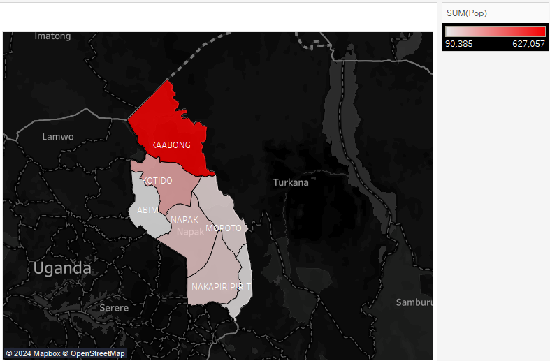
Population distribution by District.
This map displays the population distribution across different districts in Karamoja, Uganda.

Slide 4
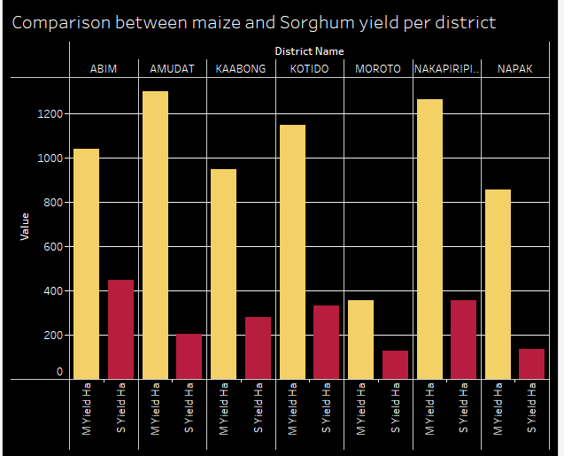
Districts Crop Yield Analysis
This comparison illustrates the variance in maize and sorghum yields across districts.

Slide 5
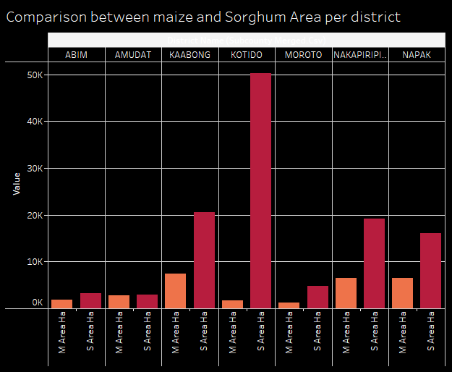
Comparison between Maize and Sorghum Area per District
This comparison illustrates the variance in maize and sorghum Area across districts.

Slide 6
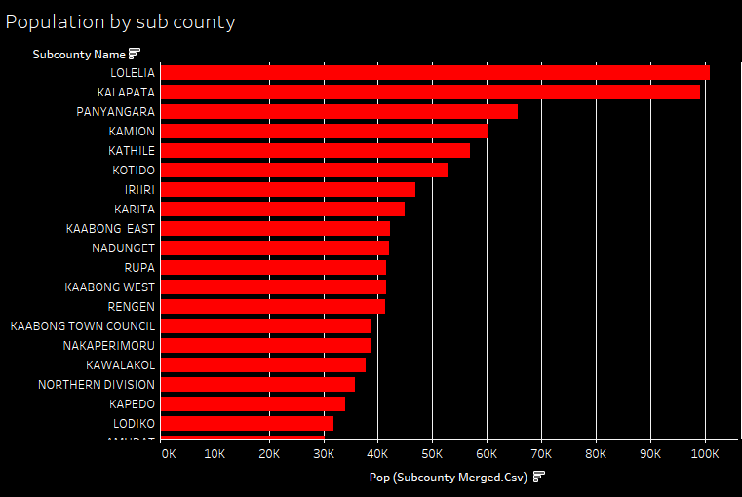
Highest populated subcounties.
A visualization to help us see the highest populated sub-counties .

Slide 7
Conclusion.
In this project, we explored different population partitions and crop yields as determined across districts and subcounties in KaraMoja Uganda. Using data linkage across different sources, we have spatially disaggregated and visualized new information pertaining to food security and agriculture planning. The visualizations also provide a clear view in terms of population by district and sub-county as well as comparative analysis between maize vs sorghum yields areas, indicating divided discrepancies or rather paths to consider for agricultural improvements.

Slide 8
Key Recommendations.
1. Precision Agriculture Development:
Such large differences in maize and sorghum yields by district imply that some areas may benefit from more targeted agricultural interventions, for example Nakapiripirit nor Kotido. Efforts to increase productivity in underperforming districts by using sustainable agricultural practices, and providing higher-quality seeds and irrigation facilities
2. Resource Allocation on Per-Person Basis:
This visualizations reveals that some subcounties like Lolelia and Kalapata are heavily populated than others. Most of these human-concentrated activities (e.g. food distribution, infrastructure building and educational services) may need to target the immediate region where majority Africa's poor already dwell in order for resource use matches demands from high population concentration areas
3. Better tracking and planning of crops;
The comparison of crop areas revealed that some districts like Kotido dedicate substantial land area to sorghum. The yields in these regions do not necessarily match the size of the land. Furthermore, crop monitoring is suggested to be expanded so that land is used sensibly and problems related to lack of soil fertility or absence of water can be caught in a timely manner.

Slide 9
By following these guides, Karamoja stakeholders surveyors can make well-informed decisions which contribute to food security and increase economic returns associated with agriproductions for the people in region.

Slide 10
Thank you!
Thank you for your time and attention. We are grateful for your interest in our work and the potential of its benefits on food security in Karamoja. We hope to hear from you and potentially work together in order continue being a driving force for change.

